Slide 1
Real Estate in India

Slide 2
List of Contents
Abstract
Introduction
Existing System
Proposed System
Modules
System Configuration & Hard Ware Configuration
Software Configuration
Diagrams
Conclusion

Slide 3
ABSTRACT:
This project is aimed at developing an Online Real Estate Agent: Real Estate in India , which is of beneficial to either a real estate agent or a prospective. The Real Estate in India is an Internet based application. This system can be used to store and search the property portfolios.
Real Estate in India is a unique virtual platform that allows any user to post a property related advertisement on the Internet without incurring costly advertisement fees. User-friendliness, reliable service together with maximum and continuous exposure is the qualities that Real Estate in India stands for. We believe that whether you are searching or selling your property online, a pleasant and hassle free experience is of utmost importance.

Slide 4

Real Estate in India offers a one-stop Real Estate in India for your ideal property. Searching for a property is made easier with our Real Estate in India engine. In this project we provide one stop Real Estate in India for both residential and commercial properties.
It saves your time by narrowing down your search for buyers, tenants or investors. Real Estate in India offers a one-stop Real Estate in India for interested buyers, tenants or investors. We are dedicated to make search fast and easy.

Slide 5
Existing System:
The current system is a manual operated system, owners and agents need to advertise their properties in local channels and news papers. In the existing system property information can be spread into limited users only.
The current system is a manual one where in the company maintains all the information in the form of records. There by collecting necessary information with require a manual search in the record(s).
Transfer of information between different sections of the enterprise is in the form of documents or letters. Drafting letters and advertisements will take time. Manually approaching the person and confirming the availability of the person do selection of a person for a advertisement. Due to mismanagement the work is delayed to later date than the due date.

Slide 6
Proposed System:
The information of the entire firm will be maintained at a centralized data base any changes made by the other departs are known to the higher or lower departments instantly. Provide Interactive interface through which a user can interact with different areas of application easily. Deploy the application on a single system and make is available on all the systems with in the network, there by reducing the maintenance cost of software.
Owner can upload his advertisements through this system interface very easily. All the property ads can display in a good format in this system. This system can be accessed by 24 X 7 modes.
The system user interface provides interaction between owners and guests. Advertisements play vital role to manage this system as a website. Different types of advertisements are accepted from the users. Administrator can play major role here.

Slide 7
MODULES:
Administrator
Manager
User
Registration
Authentication
MODULES:
Administration
Registered User (Agent/Owner)
General User (Visitor)
Services
Registration and Authentication

Slide 8
Administration
Admin login / logout function
  One portal admin ID and password will be assigned
  Change Admin password
Member list
    Tabulate list base on Member Name, Member Id, Date of Birth, and Email Id.
    Search function for Member’s name.
    Add / Edit / Delete registered users.
    Sort functions for Member Name, Member Id, Date of Birth, and Email Id.
Post-A- Property list –
Tabulated list base on Project Name, Property Type (HDB / Private / Commercial), Rent/Sales, District, Price, Published Date, Expiry Date, Member Name, Status (Active/Inactive)
Search function base on Member’s name and posted date of the Property.
View / Delete / Publish Property.
Property will only publish after Admin has been notified and approved.

Slide 9
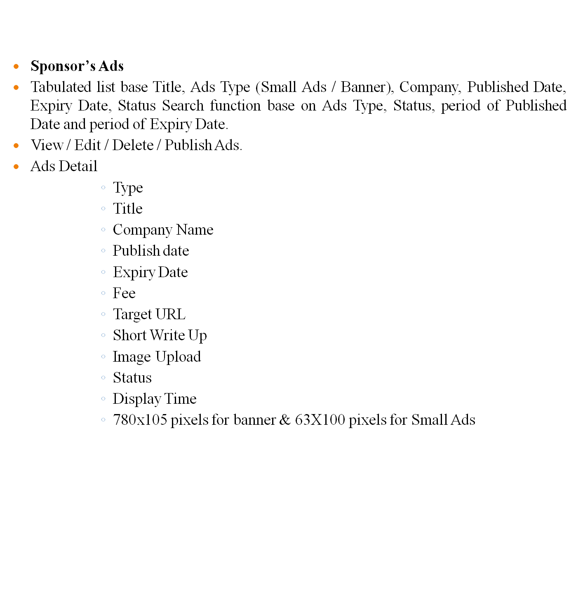

Slide 10
Registered User (Agent/Owner):-
Agent/Owner have to register itself to publish own property details on portal.
They will have login id and password.
They can change own password
They can change own profile.
They can upload own property details.
They can view all Property list.
They can send request for Renewal to the property, which is going to be expired.
General User (Visitor):-
User can visit the site portal to get the property information.
User can search the property by some condition.
User can search in two ways: First is Simplified Search and second is Advance Search.
By clicking on any property Image or More Details, user can get all details about property.
User can get the Agent/Owner Details also of Selected Property.
Services
Portal Provides different service like:
Feedback
Enquiry
Useful link

Slide 11
Registration and Authentication:-
A well defined registration process has been developed in this system, user of this system need to register first. After successful registration process a user can get his own user name and password for log in into the system.
Authentication is a process of checking user name and password. A valid user only can access the system. To accessing the system user must enter through login page.

Slide 12
SYSTEM CONFIGURATION
HARDWARE CONFIGURATION
S.NO | HARDWARE | CONFIGURATIONS
1 | Operating System | Windows 7 or above
2 | RAM | 2GB
3 | Processor (with Speed) | Intel Pentium IV (3.0 GHz) and Upwards
4 | Hard Disk Size | 40 GB and above
5 | Monitor | 15’ CRT

Slide 13
SOFTWARE CONFIGURATION
S.NO | SOFTWARE | CONFIGURATIONS
1 | Platform | Microsoft Visual Studio 2013
2 | Framework | .Net Framework 4.5
3 | Language | C#.Net
4 | Front End | Asp.net, html
5 | Back End | SQL Server 2014

Slide 14
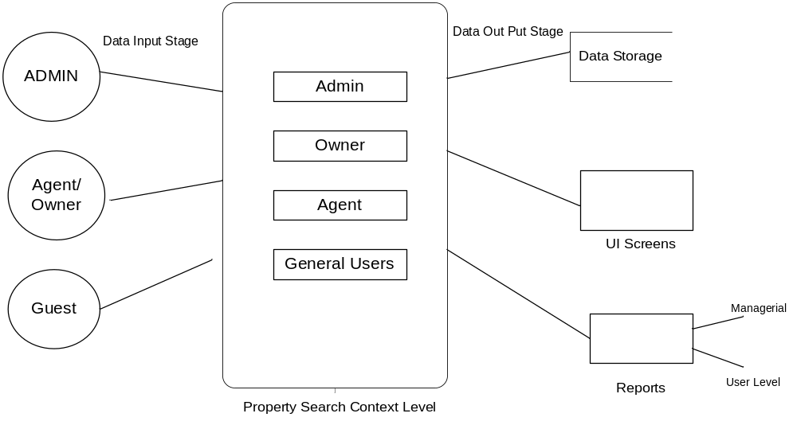
Data Flow Diagram
Context Level Diagram (0 Level)

Slide 15
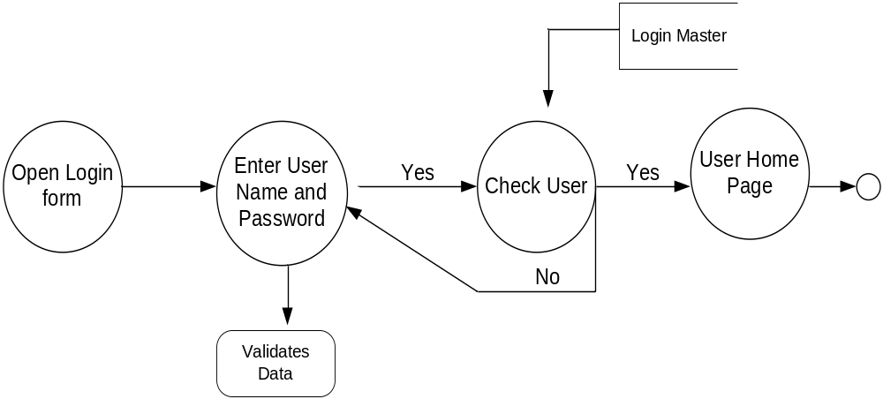
Login DFD

Slide 16
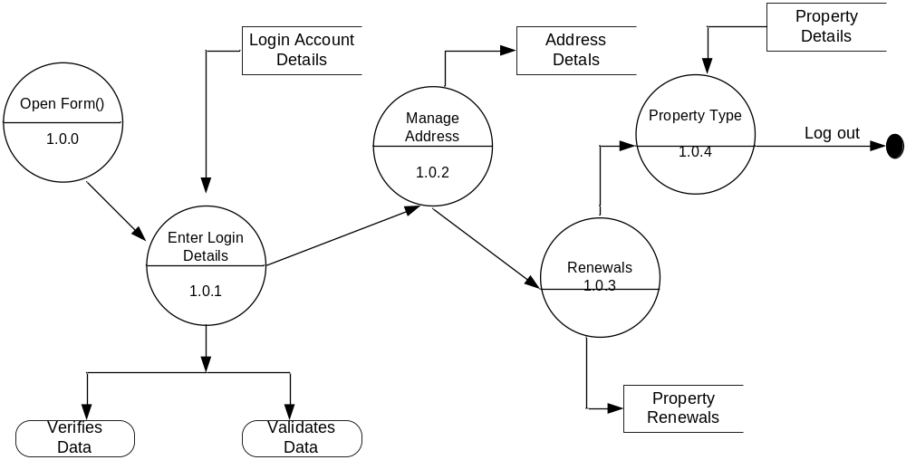
Admin First Level Data Flow Diagram

Slide 17
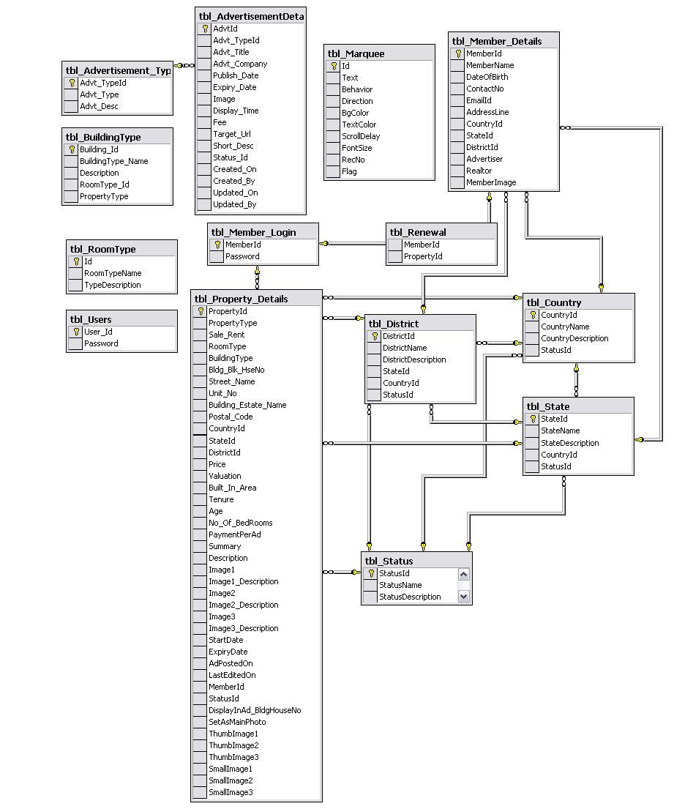
ER-Diagram

Slide 18
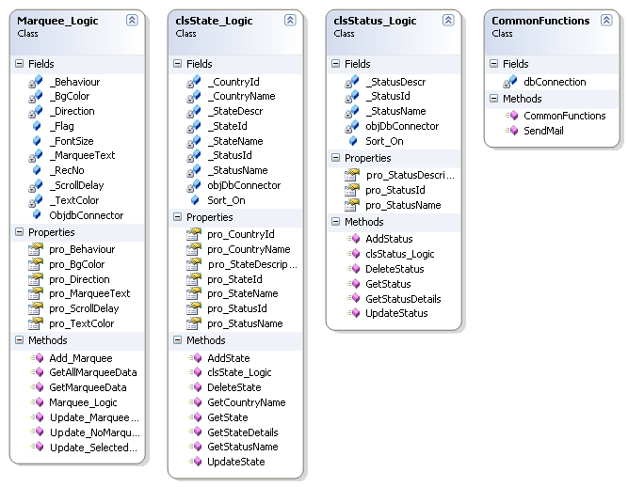
Class Diagram

Slide 19
Admin Use Case Diagram:-
System
Login
Manage Country
Manage State
Administrator
Manage City
Manage Property
Renewal Property
Log Out

Slide 20
Agent / Owner MODULE USECASE DIAGRAM
System
Login
Manage Profile
Add Property
Agent/Owner
Manage Properties
Renewal Request
Search Property
Log Out

Slide 21
VISITOR MODULE USECASE DIAGRAM
System
Home
Search Property Type
Owner Info
Feed Back
Guest
Comments
Search Property
Static Content

Slide 22
Admin Login Sequence Diagram
Administrator
Login
BL AdminMember
DL SQlHelper
Data Base
1 : Login()
2 : Validate Data()
3 : Execute NonQuery()
4 : Execute NonQuery()
5 : Response for Execute NonQuery()
6 : Get Response
7 : Show Result

Slide 23
Owner/ Agent Login
Owner
Login
BL Members
DL SQlHelper
Data Base
1 : Login()
2 : Validate Data()
3 : Execute NonQuery()
4 : Execute NonQuery()
5 : Response for Execute NonQuery()
6 : Get Response
7 : Show Result

Slide 24
User Login(Agent/Owner)
User
Login
BL Login
DL SQlHelper
Data Base
1 : Login()
2 : Validate Data()
3 : Execute NonQuery()
4 : Execute NonQuery()
5 : Response for Execute NonQuery()
6 : Get Response
7 : Show Result

Slide 25
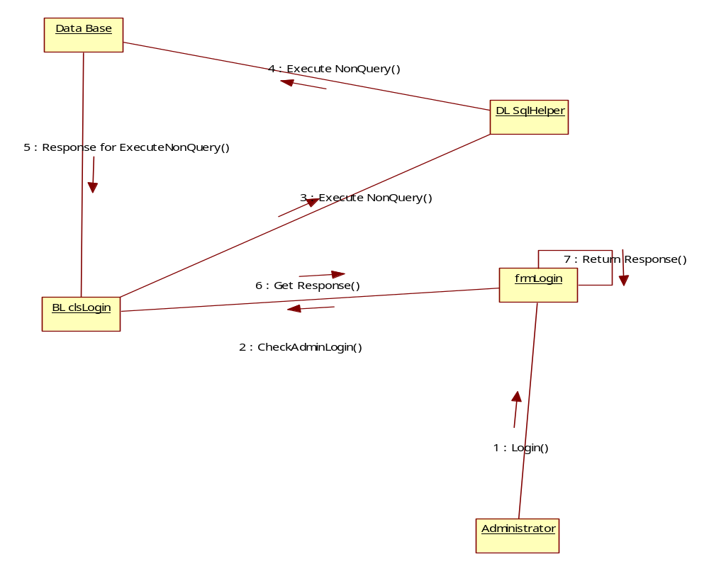
Collaboration Diagram
Admin:
Login:

Slide 26
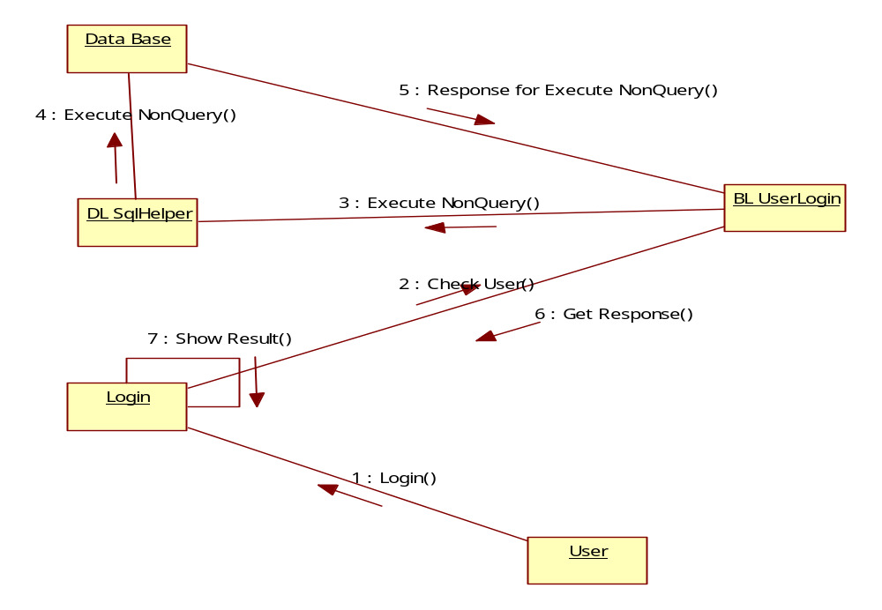
Collaboration Diagram
Owner/ Agent Login

Slide 27
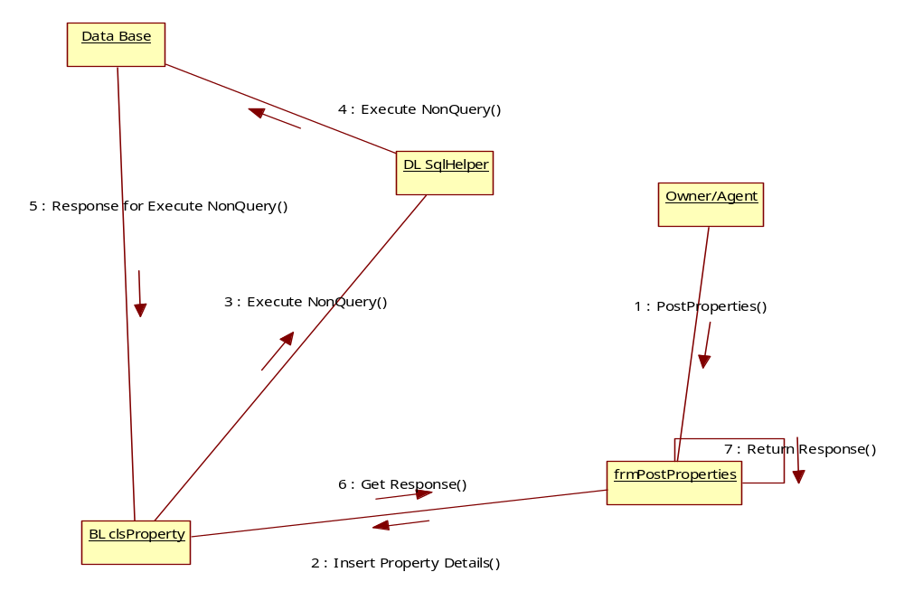
Collaboration Diagram
Agent/Owner Post Properties:-

Slide 28
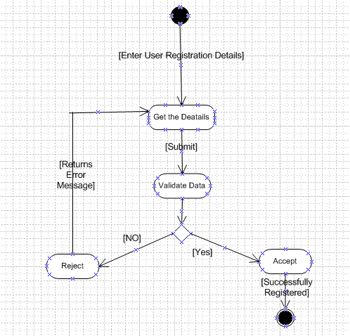
Registration Activity Diagram

Slide 29
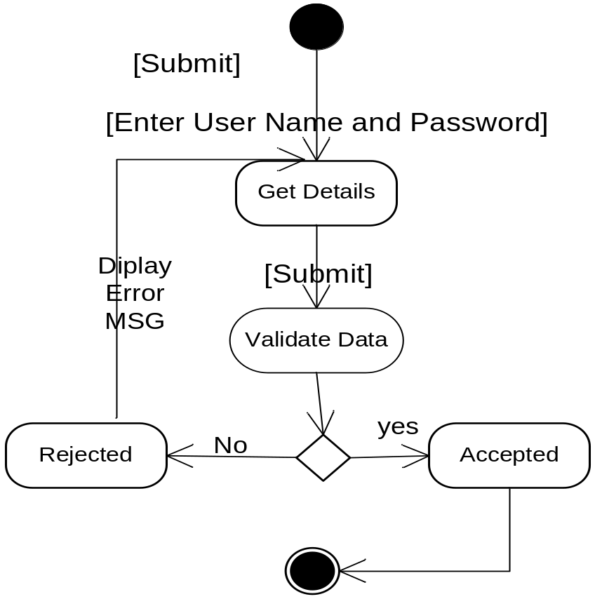
Login Activity Diagram

Slide 30
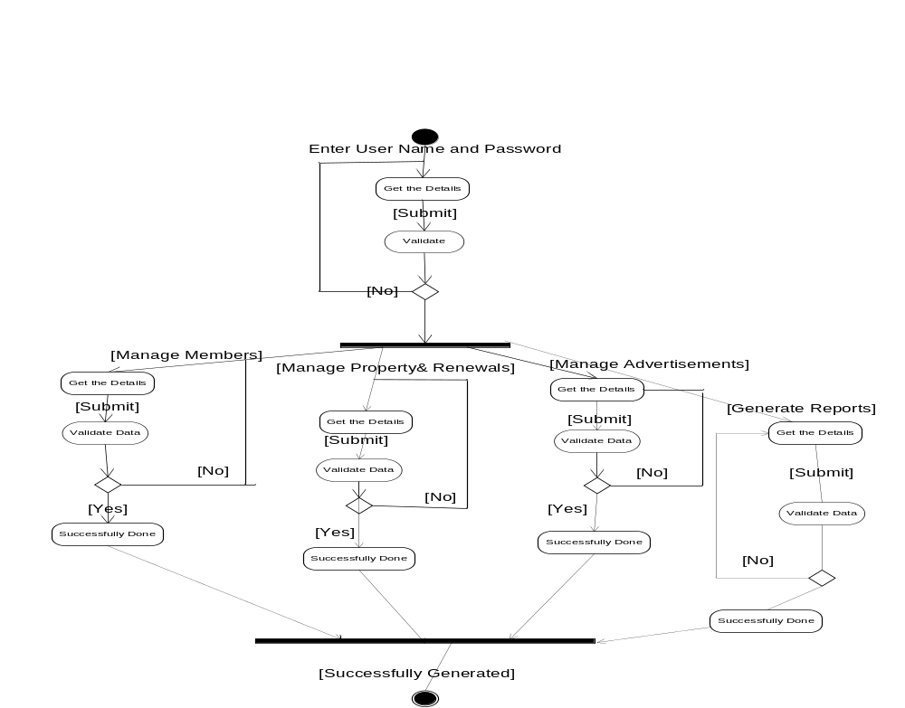
Admin Activity Diagram

Slide 31
Conclusion:-
In this project we provide one stop Real Estate in India for both residential and commercial properties. It saves your time by narrowing down your search for buyers, tenants or investors. Real Estate in India offers a one-stop Real Estate in India for interested buyers, tenants or investors. We are dedicated to make search fast and easy.

Slide 32

Querrys:-

Slide 33


